Slide 1
Business Model Canvas
Dr. Glory Aguzman, S.Sos, M.M., CDMS, CCP

Slide 2
Subtopics
Business Model Canvas
Customer Segment
Value Proposition
Channel
Customer Relationship
Revenue Stream
Key Activities
Key Resources
Key Partnerships
Cost Structure
Google Business Model Canvas
Template Business Model Canvas
Student Activities
Next Session Preparation

Slide 3
Acknowledgement
Osterwalder, A., & Pigneur, Y. (2010). Business model generation: a handbook for visionaries, game changers, and challengers. John Wiley & Sons

Slide 4
Learning Outcome
LO3: Create a business report and pitch deck for sustainable business development.

Slide 5

Business Model Canvas
Why use it?
● Plan your strategy
● Share your vision
● Identify gaps
● Grow your business

Slide 6
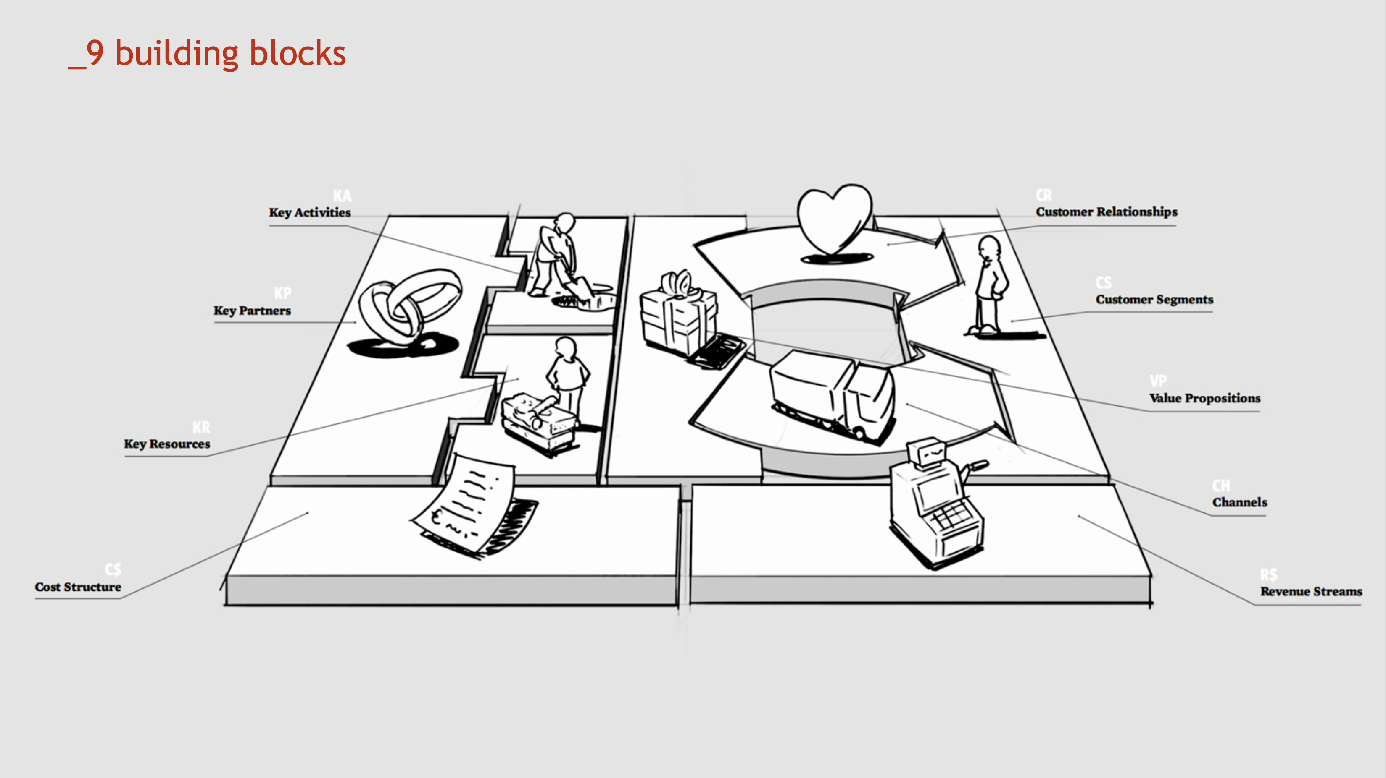
Business Model Canvas

Slide 7
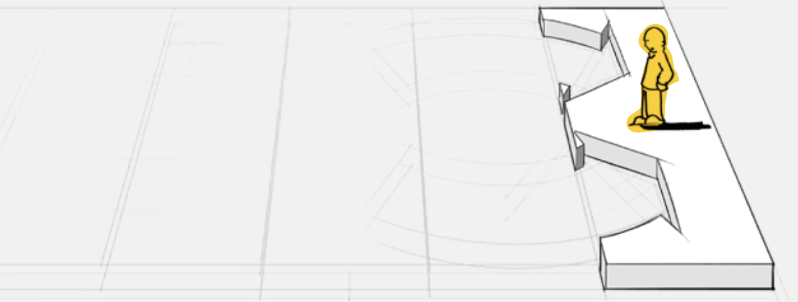
Customer Segments
.
●
Customers comprise the heart of any business model. Without (profitable) customers, no company can survive for long. In order to better satisfy customers, a company may group them into distinct segments with common needs, common behaviors, or other attributes. A business model may define one or several large or small customer segments. An organization must make a conscious decision about which segments to serve and which segments to ignore. Once this decision is made, a business model can be carefully designed around a strong understanding of specific customer needs.
Customer groups represent separate segments if:
Their needs require and justify a distinct offer
They are reached through different distribution channel
They require different types of relationships
They have substantially different profitabilities
They are willing to pay for different aspects of the offer
The Customer Segments Building Block defines the different groups of people or organisations an enterprise aims to reach and serve

Slide 8
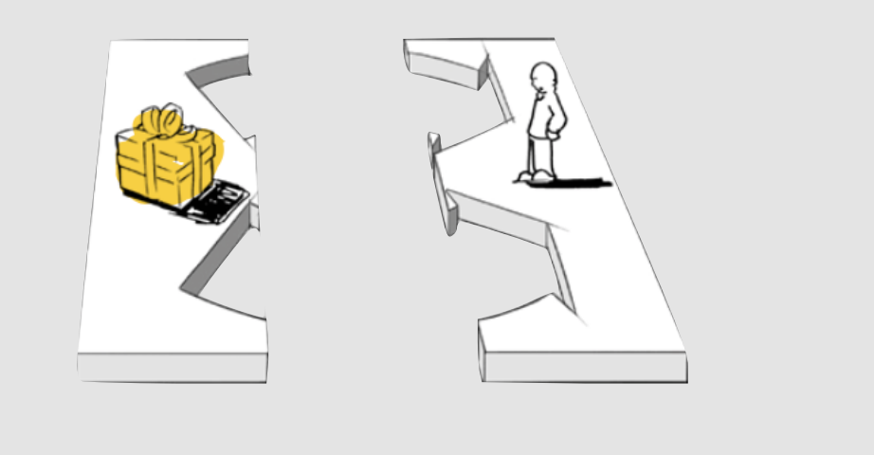
Value Proposition
●
The Value Proposition is the reason why customers turn to one company over another. It solves a customer problem or satisfies a customer need.
Each Value Proposition consists of a selected bundle of products and/or services that caters to the requirements of a specific Customer Segment.
The Value Propositions Building Block describes the bundle of products and services that create value for a specific Customer Segment

Slide 9
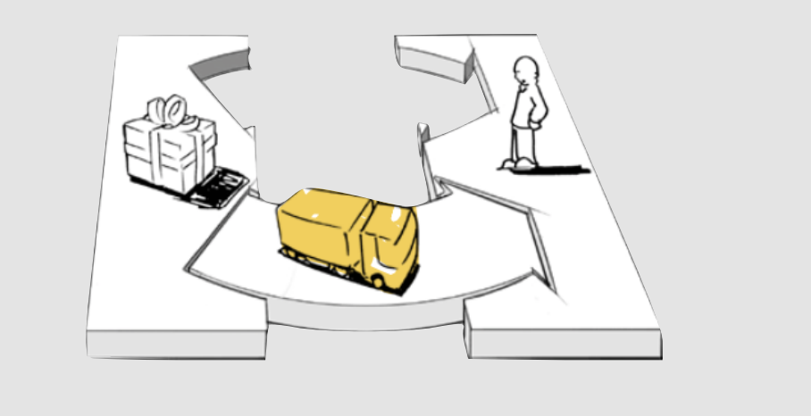
Channel
●
Communication, distribution, and sales Channels comprise a company's interface with customers.
Channels are customer touch points that play an important role in the customer experience.
Channels serve several functions, including:
Raising awareness among customers about a company’s products and services
Helping customers evaluate a company’s Value Proposition
Allowing customers to purchase specific products and services
Delivering a Value Proposition to customers
Providing post-purchase customer support
The Value Propositions Building Block describes the bundle of products and services that create value for a specific Customer Segment

Slide 10
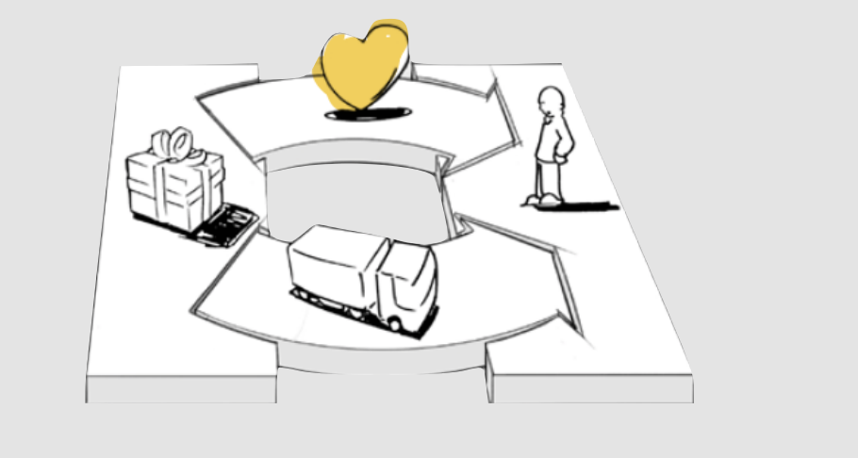
Customer Relationship
●
A company should clarify the type of relationship it wants to establish with each Customer Segment. Relationships can range from personal to automated.
Customer relationships may be driven by the following motivations:
Customer acquisition
Customer retention
Boosting sales (upselling)
The Customer Relationships Building Block describes the types of relationships a company establishes with specific Customer Segments

Slide 11
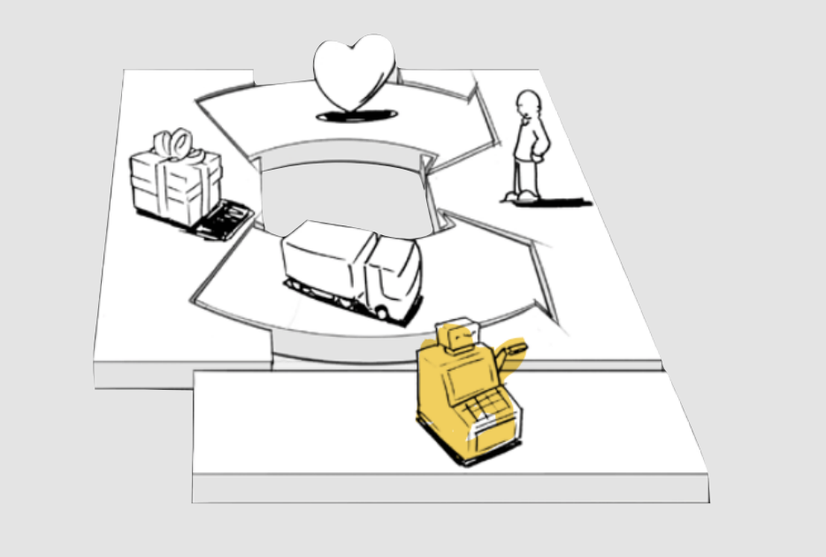
Revenue Stream
●
If customers comprise the heart of a business model, revenue streams are its arteries. A company must ask itself: For what value is each customer segment truly willing to pay? Successfully answering that question allows the firm to generate one or more revenue streams from each customer segment.
Each revenue stream may have different pricing mechanisms, such as fixed list prices, bargaining, auctioning, market dependency, volume dependency, or yield management.
A business model can involve two different types of revenue streams:
Transaction revenues resulting from one-time customer payments
Recurring revenues resulting from ongoing payments to either deliver a value proposition to customers or provide post-purchase customer support
The Revenue Streams Building Block represents the cash a company generates from each Customer Segment (costs must be subtracted from revenues to create earnings)

Slide 12
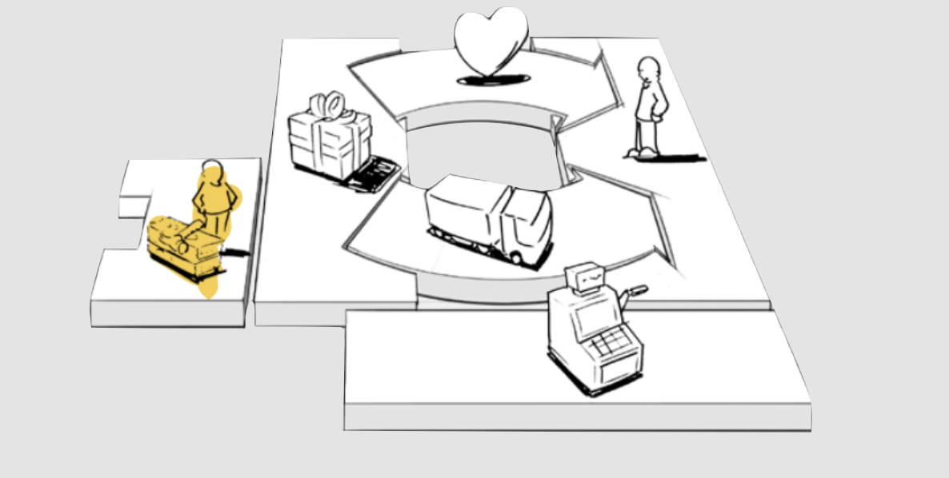
Key Resources
●
Every business model requires Key Resources. These resources allow an enterprise to create and offer a Value Proposition, reach markets, maintain relationships with Customer Segments, and earn revenues. Different Key Resources are needed depending on the type of business model.
A microchip manufacturer requires capital-intensive production facilities, whereas a microchip designer focuses more on human resources. Key resources can be
Physical
Financial
Intellectual
human.
Key resources can be owned or leased by the company or acquired from key partners.
The Key Resources Building Block describes the most important assets required to make a business model work

Slide 13
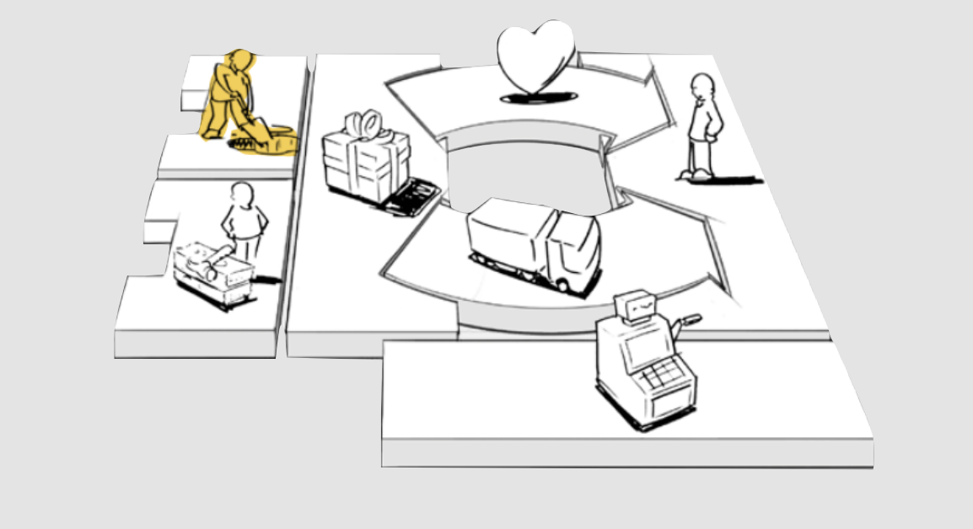
Key Activities
●
Every business model calls for a number of Key Activities. These are the most important actions a company must take to operate successfully.
Like Key Resources, they are required to create and offer a Value Proposition, reach markets, maintain Customer Relationships, and earn revenues.
And like Key Resources, Key Activities differ depending on business model type.
For software maker Microsoft, Key Activities include software development. For PC manufacturer Dell, Key Activities include supply chain management.
For consultancy McKinsey, Key Activities include problem solving.
The Key Activities Building Block describes the most important things a company must do to make its business model work

Slide 14
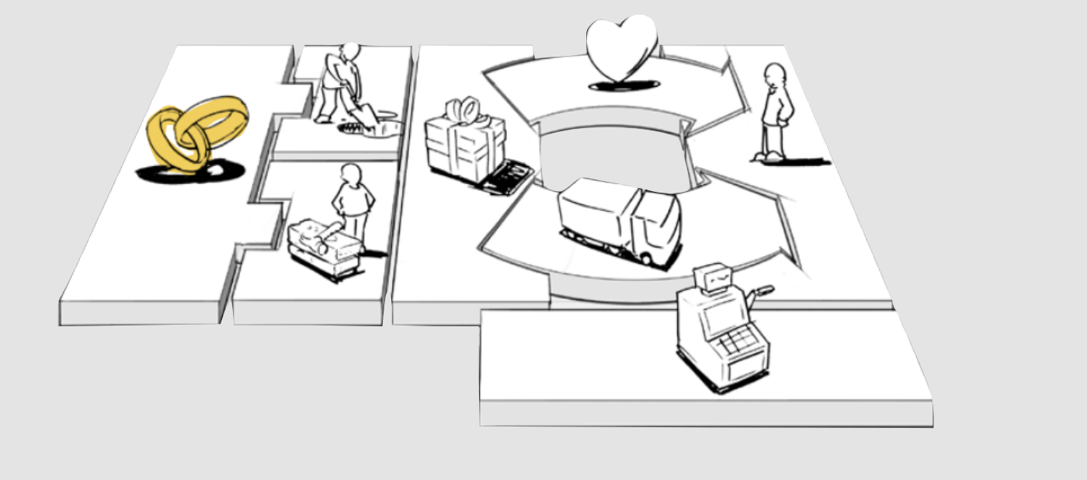
Key Partnerships
●
Companies forge partnerships for many reasons, and partnerships are becoming a cornerstone of many business models. Companies create alliances to optimize their business models, reduce risk, or acquire resources. We can distinguish between four different types of partnerships:
Strategic alliances between non-competitors
Coopetition: strategic partnerships between competitors
Joint ventures to develop new businesses
Buyer-supplier relationships to assure reliable supplies
The Key Partnerships Building Block describes the network of suppliers and partners that make the business model work

Slide 15
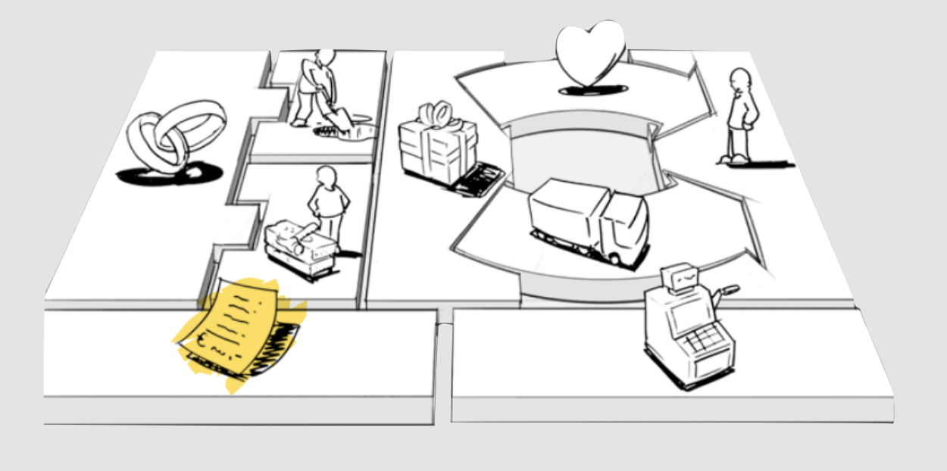
Key Partnerships
●
This building block describes the most important costs incurred while operating under a particular business model. Creating and delivering value, maintaining customer relationships, and generating revenue all incur costs.
Such costs can be calculated relatively easily after defining key resources, key activities, and key partnerships.
Some business models, however, are more cost-driven than others. So-called “no-frills” airlines, for instance, have built business models entirely around low-cost structures.
The Cost Structure describes all costs incurred to operate a business model

Slide 16
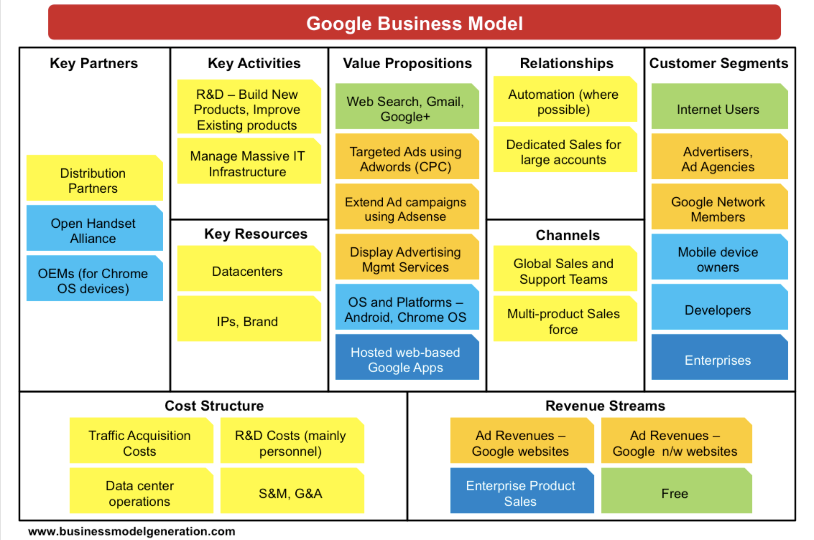
Google Business Model Canvas
●

Slide 17
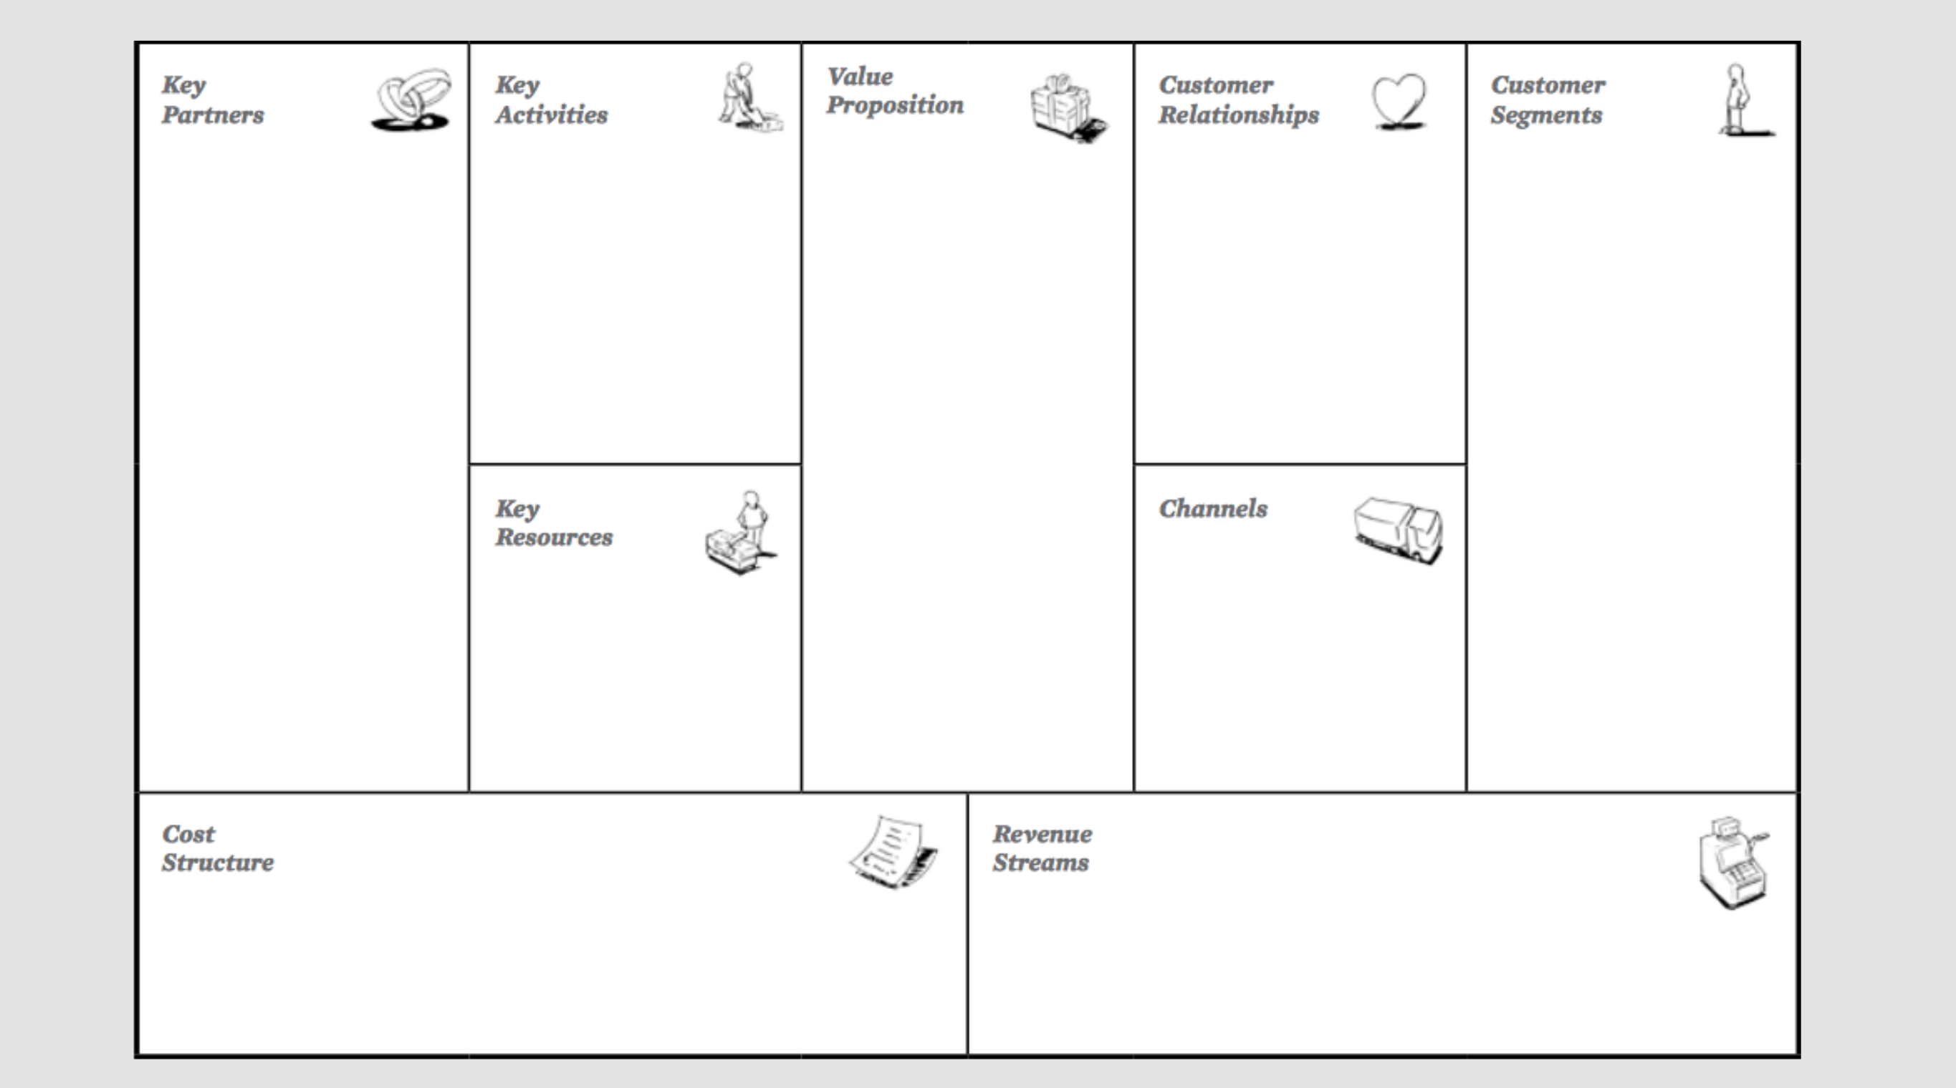
Template Business Model Canvas
●
7
4
8
6
2
3
1
9
5

Slide 18
“There’s not a single business model . . . There are really a lot of opportunities and a lot of options, and we just have to discover all of them.”
Tim O’Reilly, CEO, O'Reilly

Slide 19
Student Activities
Create Business Model Canvas
Coaching
Feedback Session

Slide 20
Next Session Preparation
Student Present:
Product Or Service show to Domain expert
Present Business Model Canvas
Domain Expert Feedback

Slide 21
References
Osterwalder, A., & Pigneur, Y. (2010). Business model generation: a handbook for visionaries, game changers, and challengers. John Wiley & Sons

